Slide 1

CSC256
Welcome!
Notes:
Start recording!!!

Slide 2
Welcome to CSC256!
Please call me Rae, Ms. Crusoe, or Prof. Rae
A little bit about me:
I developed my first website in the 1900’s
I have worked in the banking, financial services, economic consulting, and non-profit fields
I have a Bachelor of Science in Computer Information Systems
I have a Master of Science in Information Management
I started teaching college classes in 2008
I have some form of Aphantasia

Slide 3
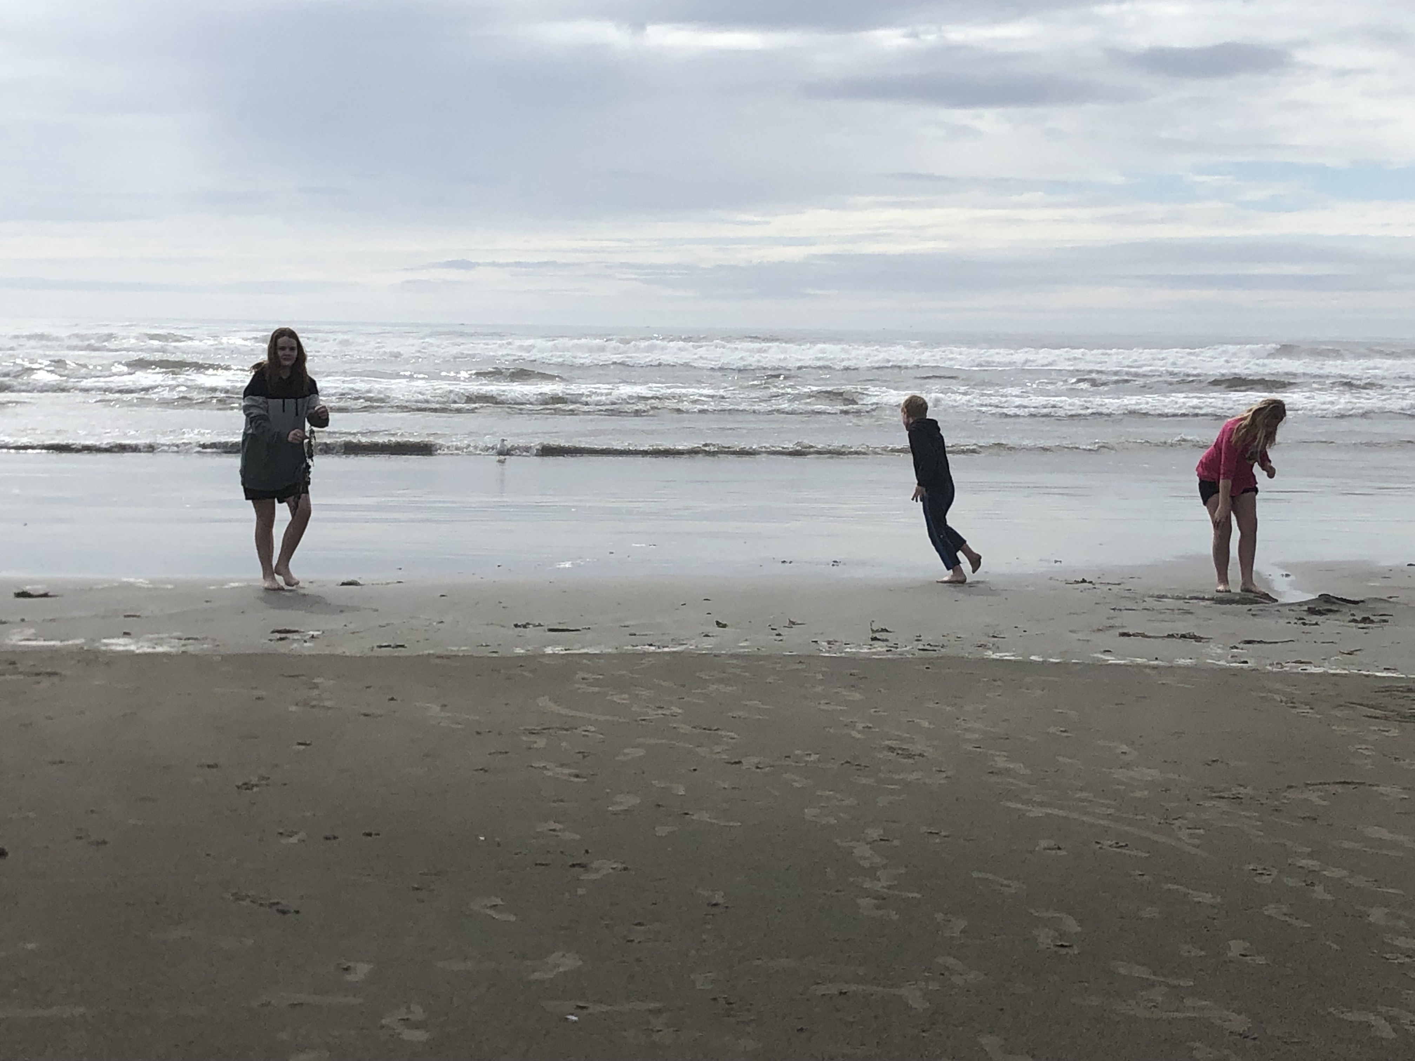
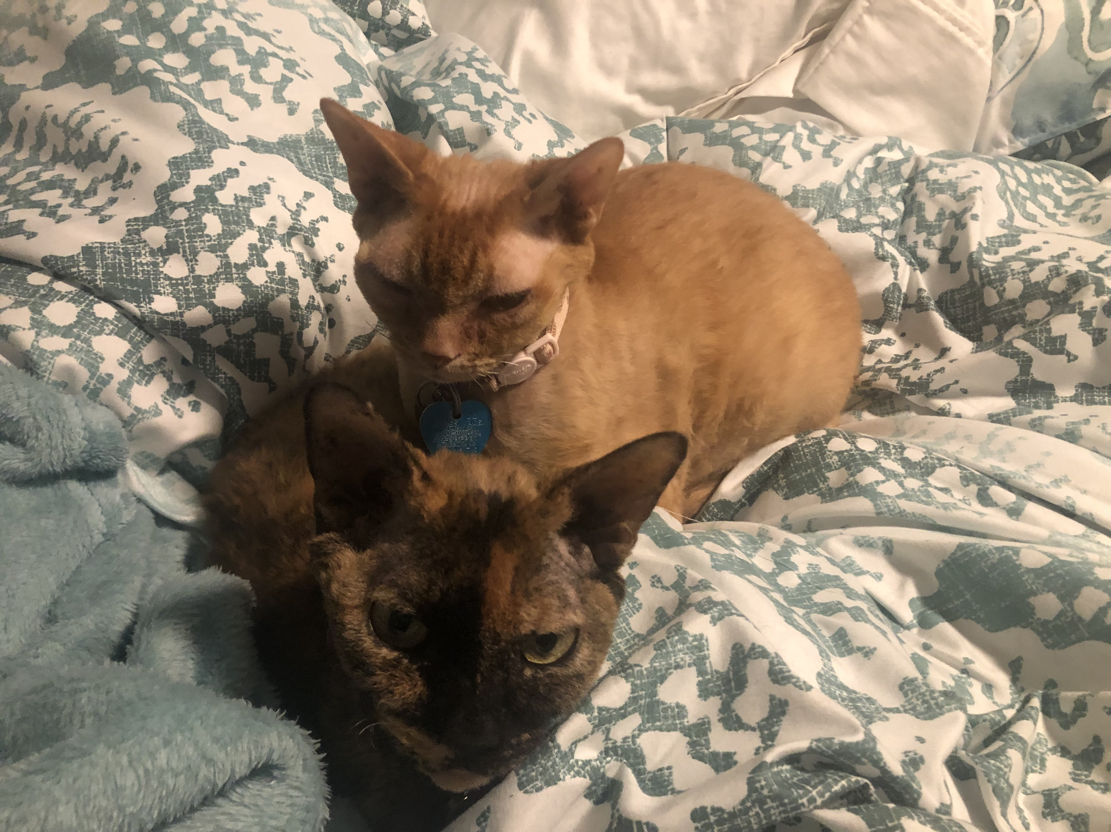
Kids Jette and Patches

Slide 4
Introduce yourself
What is your preferred name?
Why are you taking this class?
What would you like to learn in this class?
What are your interests?
What is/are your major(s)?
What is your experience with website development?

Slide 5
Course overview
This is an intermediate course in client-side coding of enhanced dynamic websites, incorporating the use of HTML/CSS, JavaScript, and AJAX. In this class, students will build functional websites that exhibit professional site planning, design and development. In addition, JavaScript will be utilized to advance the website to include GUI functionality such as buttons, picture carousels, and panels. Students will learn how to use current web development software and an integrated development environment (IDE) to support coding.
Notes:
You will learn the foundations of web development in this class.

Slide 6
Syllabus
Please review the syllabus.
Assignments: 52% Discussions: 18% Final Project: 30%

Slide 7
Textbook
JavaScript Programming, Real World Code & Explanations,
For Beginners: 2 Books in 1
Kindle Textbook
You should receive an email from Amazon
Problems – contact: ResourceTeam@uat.edu

Slide 8
Success in this class
Ask questions!
Read through the module contents each week
Attend class or watch the recordings
Participate in the class discussions
Overcommunicate with me
Start assignments early
Do not let perfect be the enemy of good
Ask questions!

Slide 9
Resubmission & Late Policies
You can resubmit any assignment. Resubmissions after the due date will accrue a late penalty, so submit your work early!
I assess a 2% late penalty per assignment.
If the assignment is 5 days late, it will lose 10% (a full letter grade)
If the assignment is 10 days late, it will lose 20% (2 full letter grades)
I may not be able to offer written feedback on late work.
No late work accepted more than 2 weeks after the due date.

Slide 10
Discussions
There are 9 discussions.
For full credit, you must review and respond to at least 2 classmates’ posts with more than just a sentence. Asking a question is a great way to create a substantive reply.

Slide 11
Assignments
There are usually 1 or 2 deliverables due per week
11 Assignments
5 Final Project Assignments
Reminder - Final Project: 30% of the final grade

Slide 12
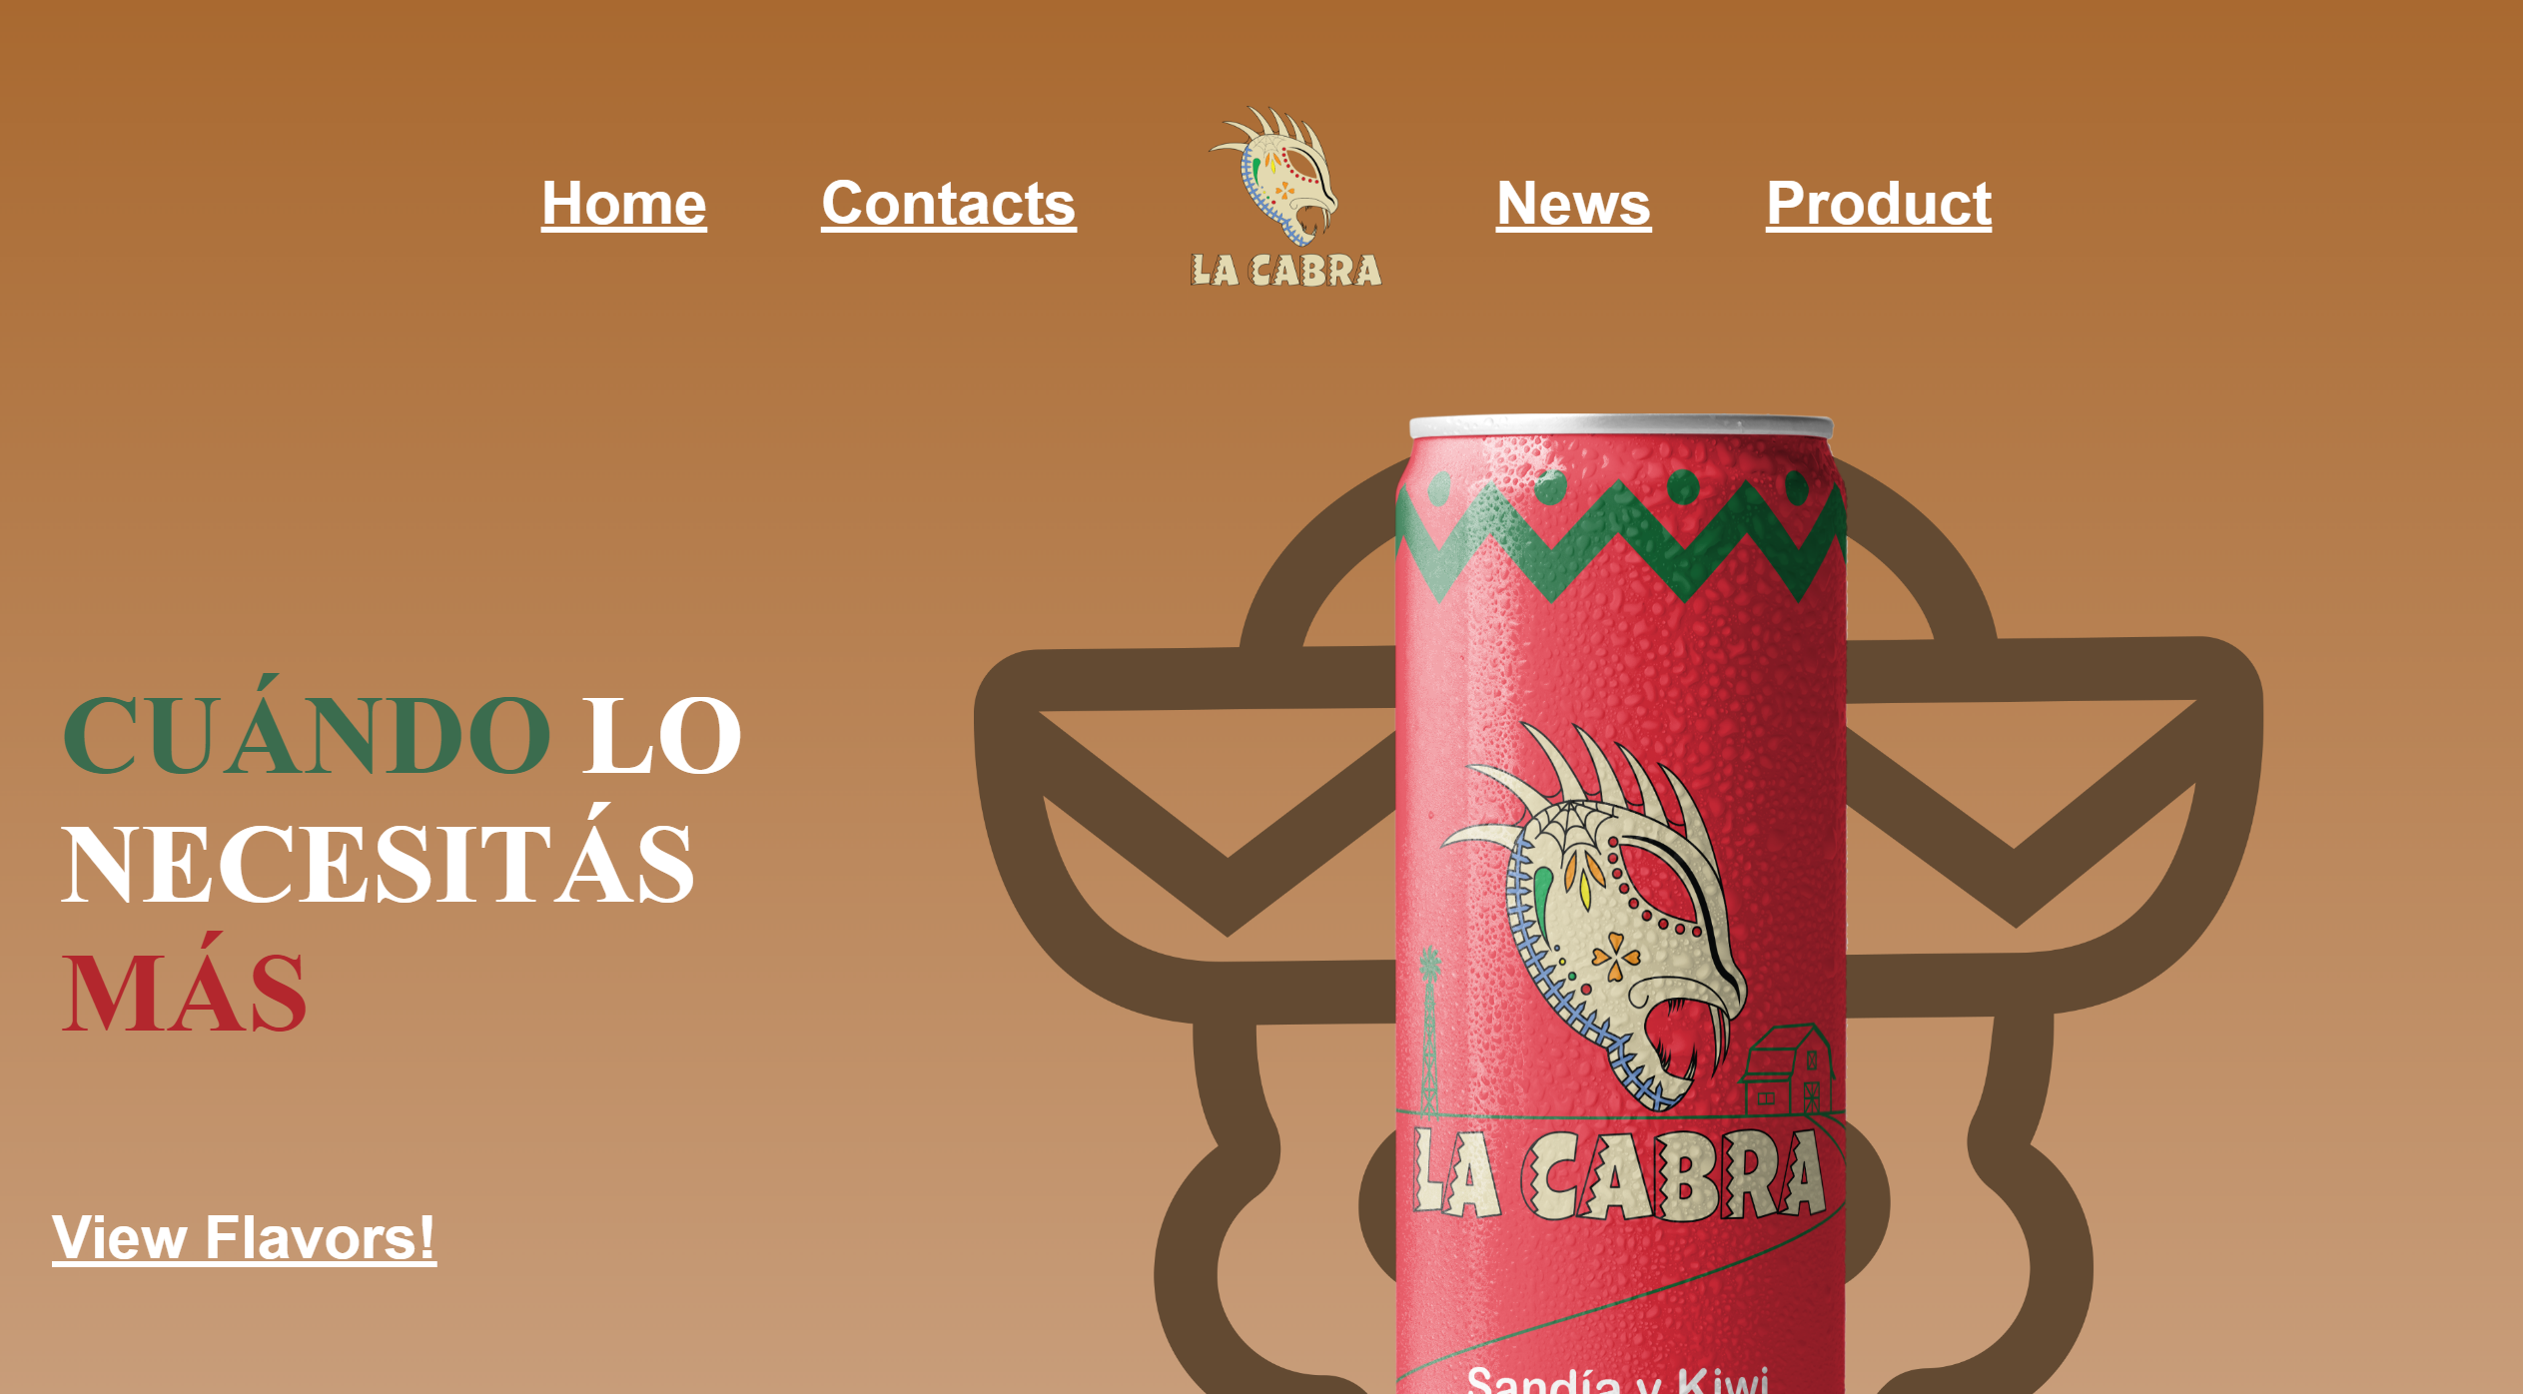
Intermediate Web Design

Slide 13
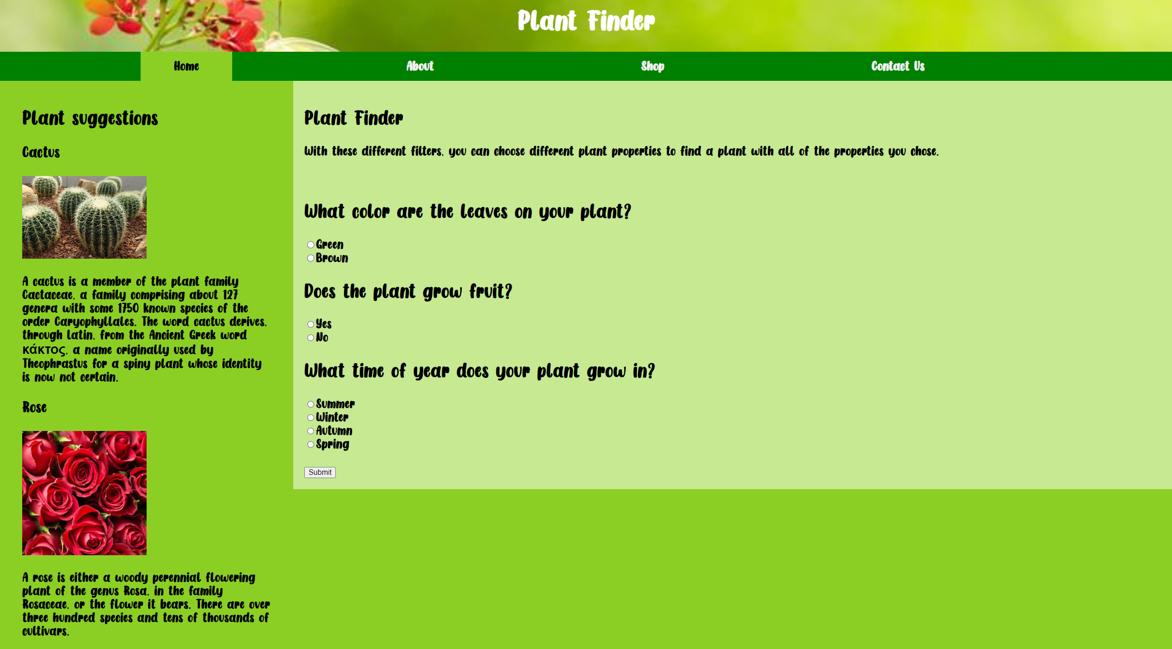
Intermediate Web Design

Slide 14
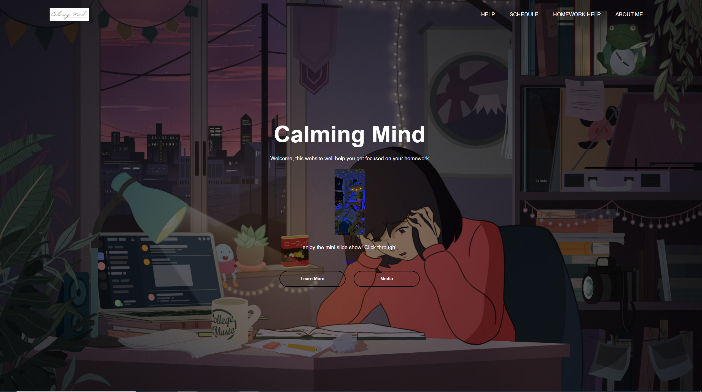

Slide 15
Tools for HTML
A basic text editor
Visual Studio Code, Notepad, Notepad++
Or any text editor of your choice
Do NOT use a Content Management System (CMS)!
You will learn your craft by coding yourself
Dreamweaver or WordPress will teach you how to drag and drop, not how to code and debug

Slide 16
Contact me
Ask questions!
Email me: rcrusoe@uat.edu
Teams chat
Teams video / Zoom

Slide 17
Deliverables
Today complete:
Introduction Survey
Discussion 1.1: Introduction
Late Policy Acknowledgement Survey
This week complete:
Assignment 1.1: Building your own Intellectual Capital with GitHub
Assignment 1.2: Review and Practice HTML/CSS

Slide 18
Question time…

Slide 19
Create a GitHub Account
https://github.com

